Slide 1
ROUTING CRISIS (CISCO PACKET TRACER)

Slide 2
SCOPE OF THE SUBJECT
Situation
HQ reports that Bravo can ping Charlie, but HQ cannot reach Charlie.
Tasks
Build the above topology in Cisco Packet Tracer.
Configure:
R1 and R2 using OSPF
R3 using EIGRP

Slide 3
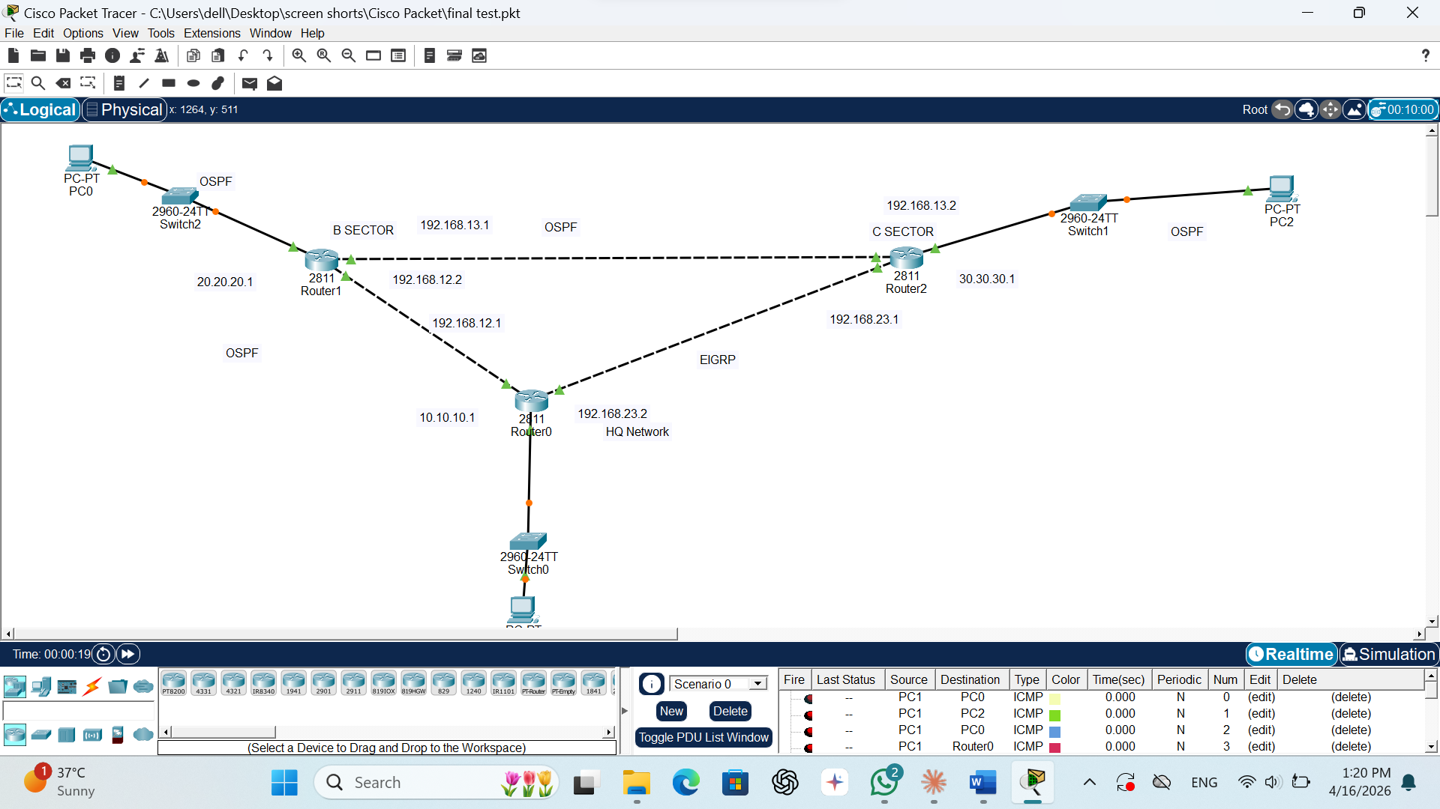
SCREEN SHOT

Slide 4
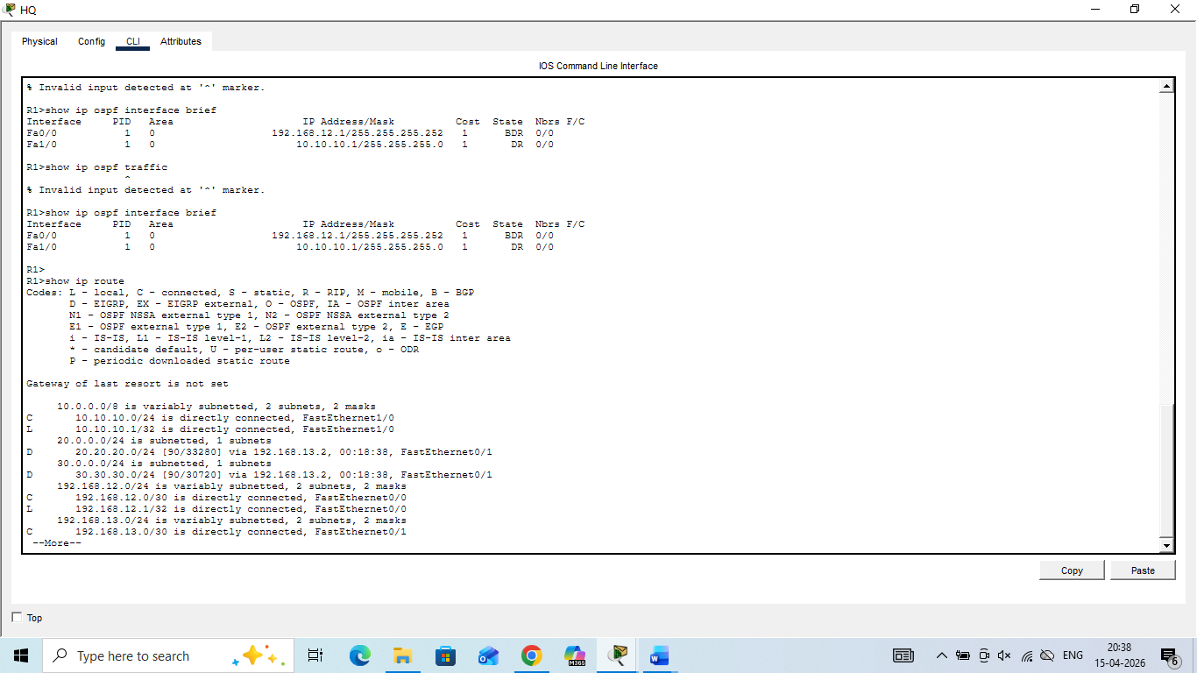
SCREEN SHOT

Slide 5
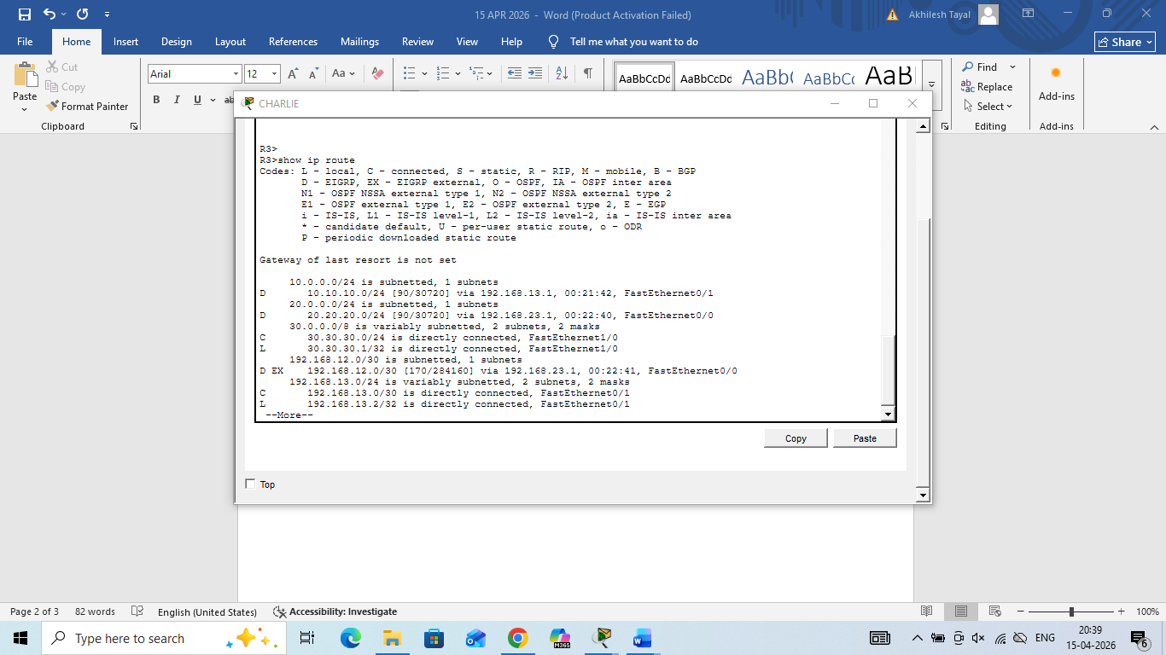
R3 USING EIGRP

Slide 6
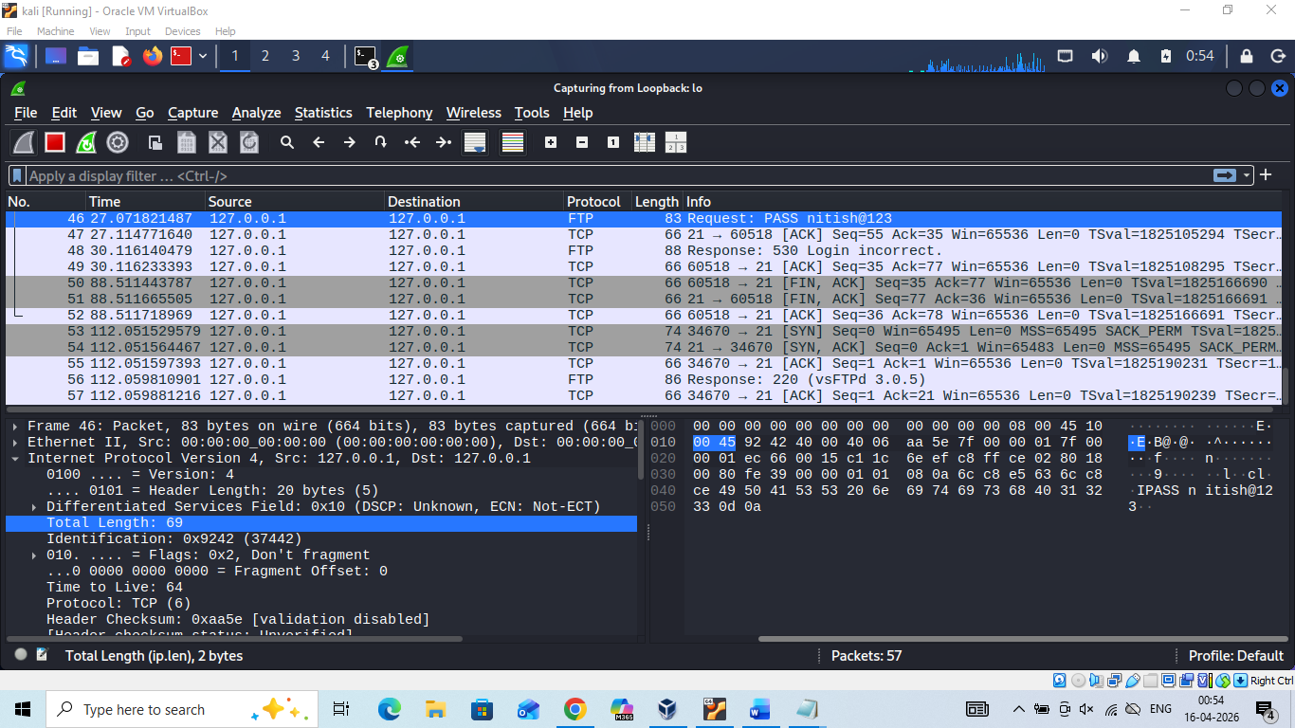
FTP LOGIN

Slide 7
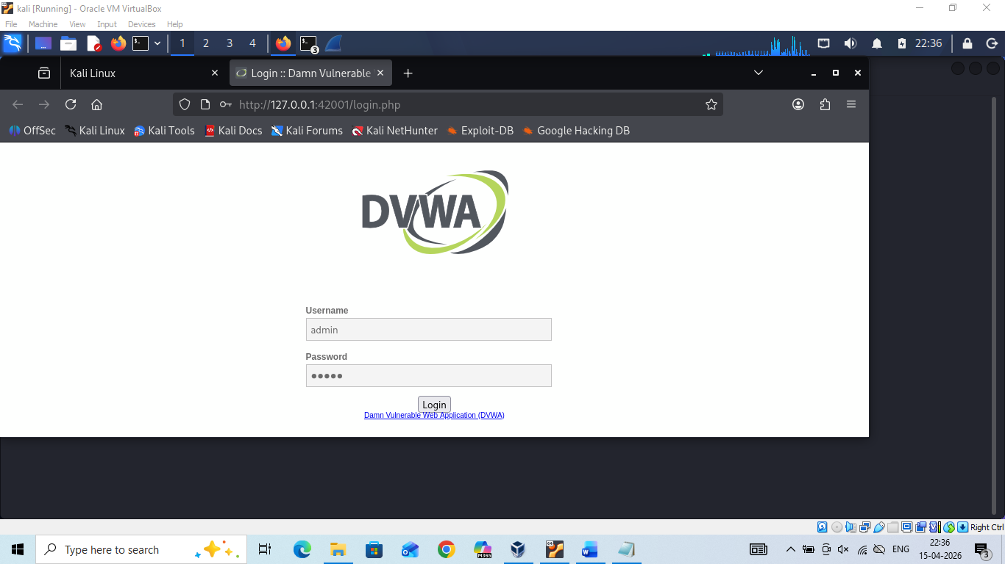
DVWA

Slide 8
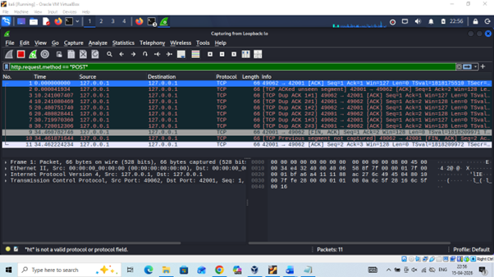
DVWA

Slide 9
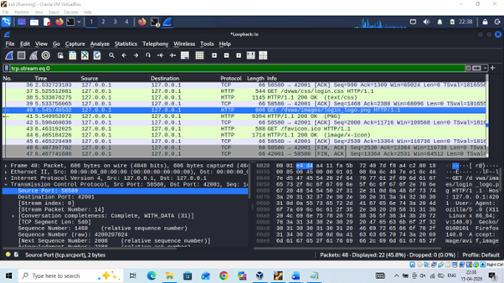
DVWA

Slide 10
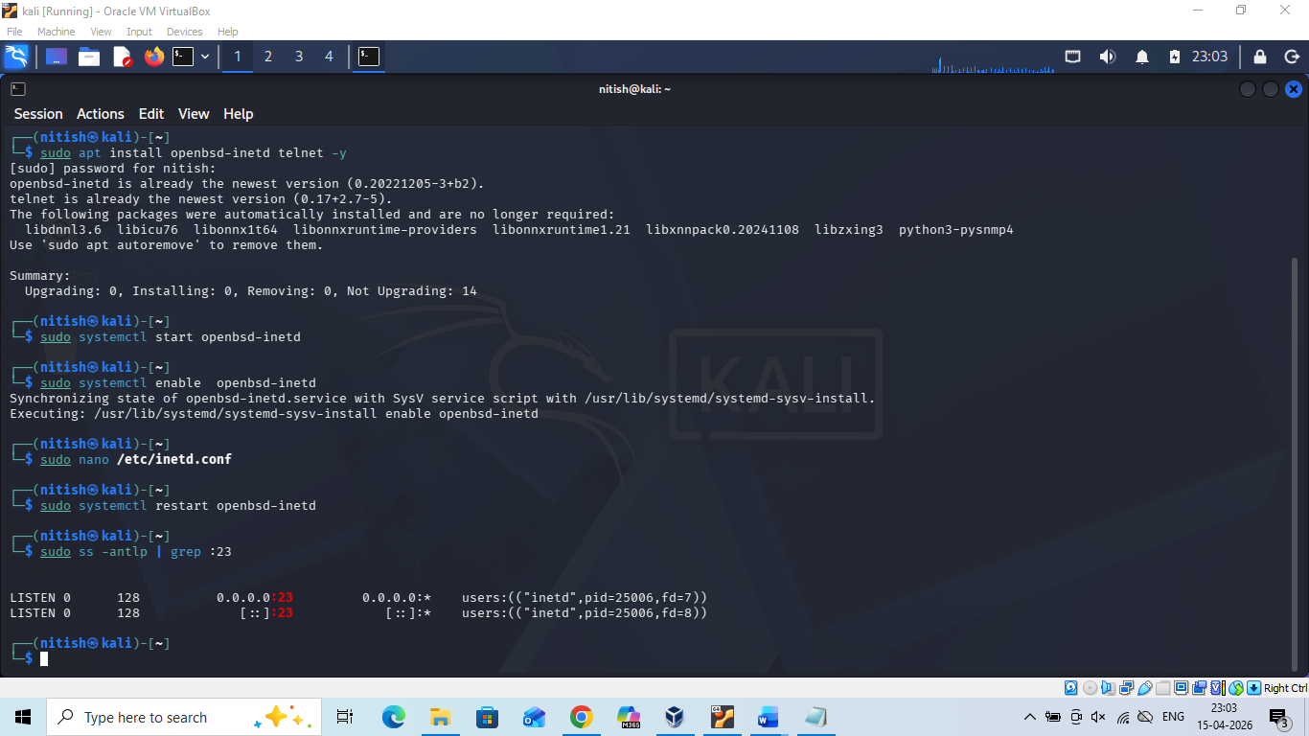
TELNET

Slide 11
TELNET

Slide 12
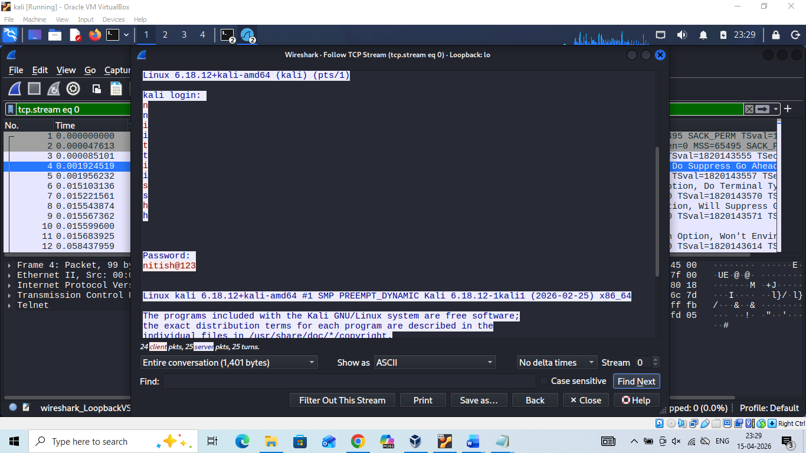
TELNET

Slide 13
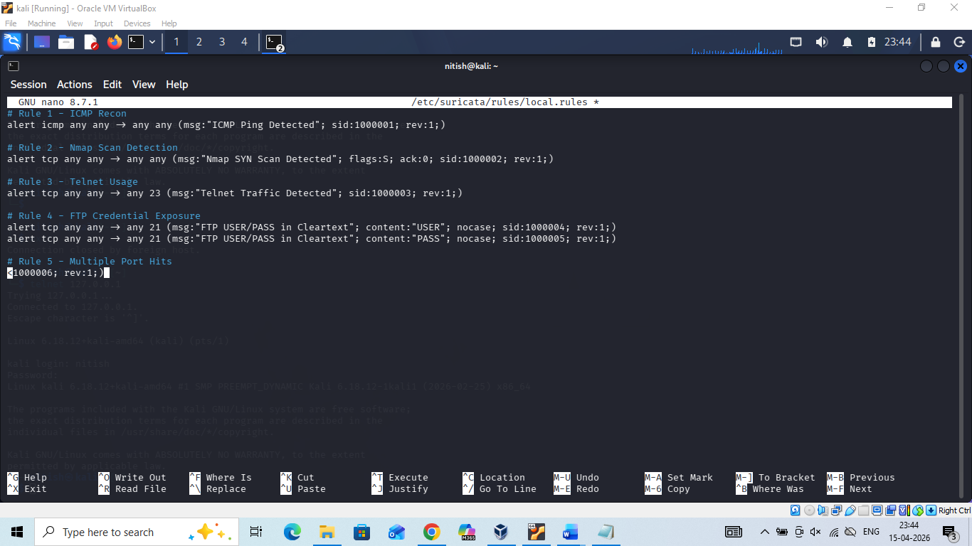
IDS SURICATA

Slide 14
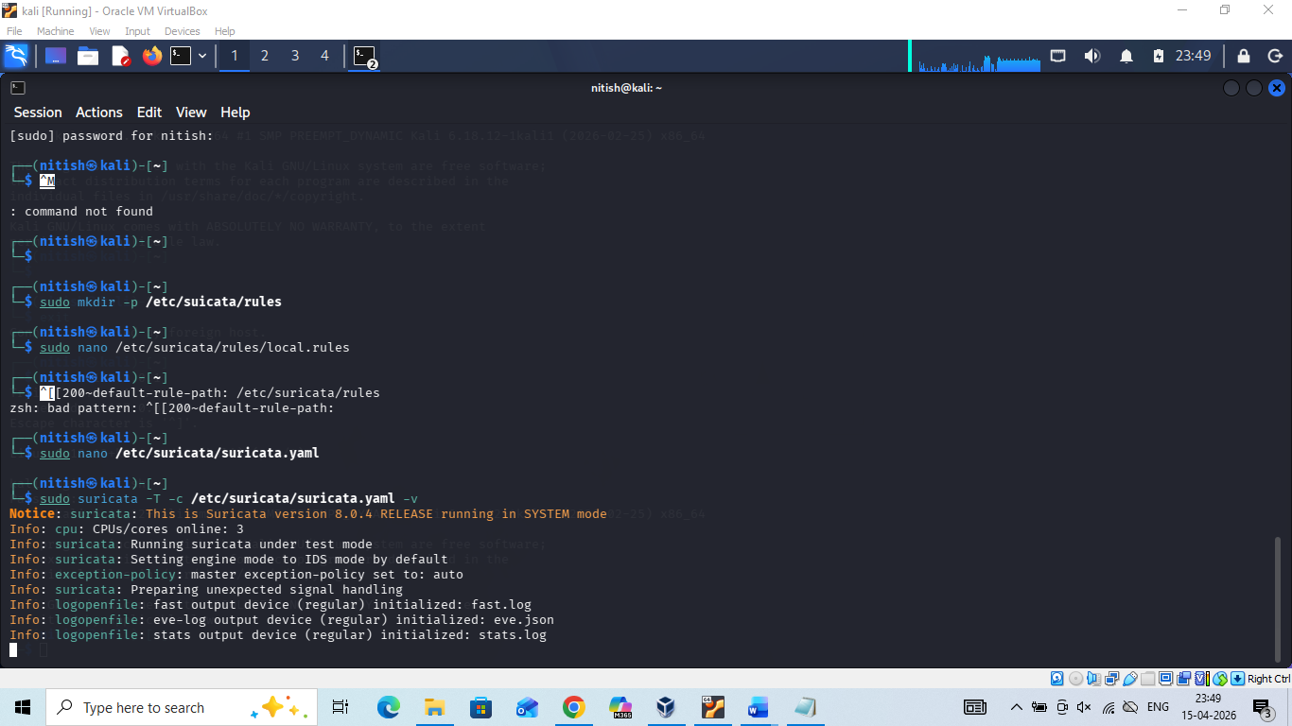
IDS SURICATA

Slide 15
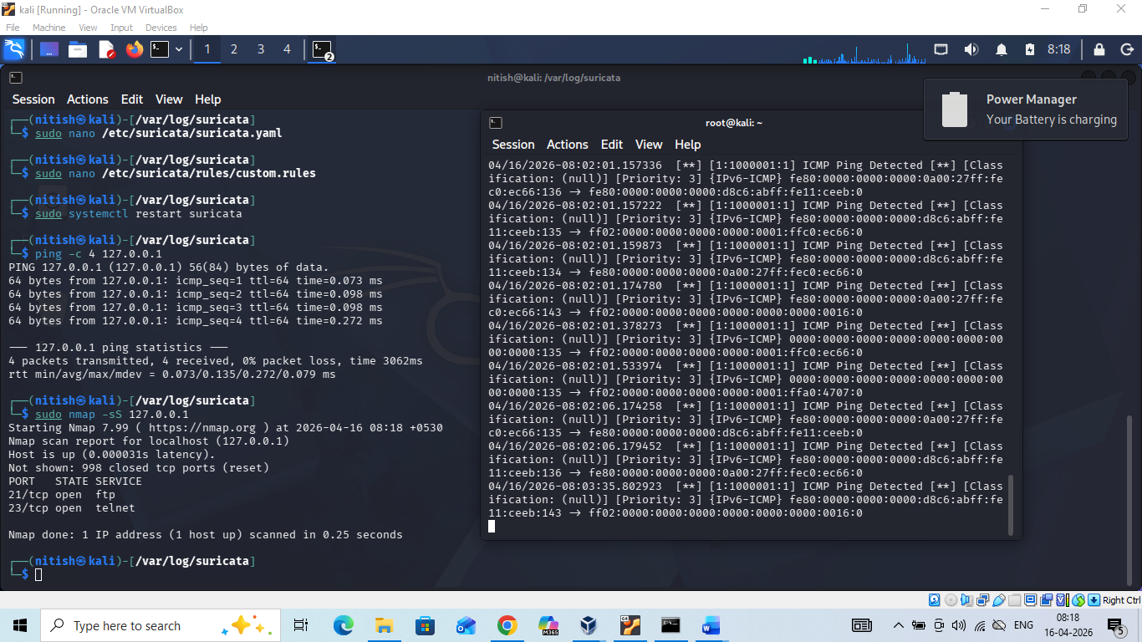
IDS SURICATA

Slide 16
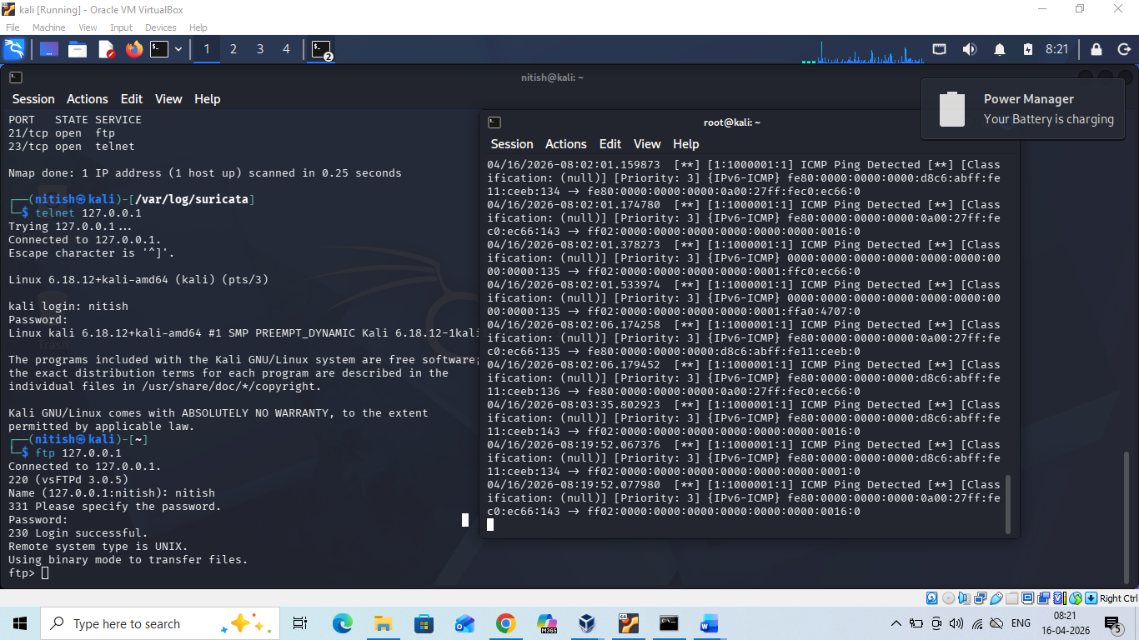
IDS SURICATA

Slide 17
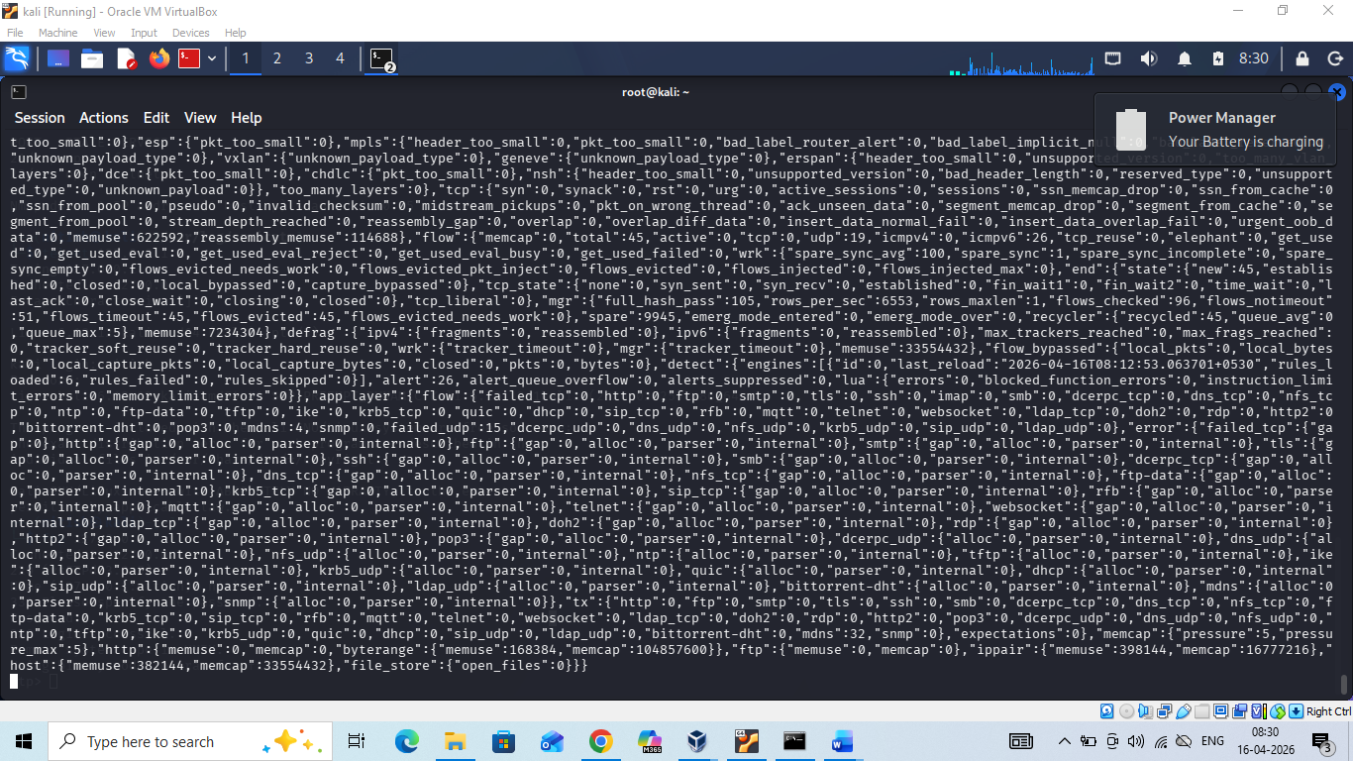
IDS SURICATA

